Slide 1
Washington, DC/Manassas Battlefields
Presents the
2018 Knox County
Safety Patrol Trip
June 1-4, 2018

Slide 2
Go Student Tours is a division of the MARS family of brands which also includes:
Go Sports Tours & SoccerTours.net.
MARS is celebrating its 20th Anniversary in 2017 as the choice for tour operators specializing in Washington, DC, and the Mid Atlantic region, including the key destinations of NYC, Philadelphia, Williamsburg, Gettysburg, and Boston. Washington, DC, remains our largest destination where we operate over 300 tours every year. Since 1997, MARS has been successfully operating custom designed tours for both student and adult groups. AAA is one of our largest repeat clients and they chose MARS to partner with for the initial proposal for Knox County Schools.
Go Student Tours was added to focus on the unique needs and interests of students. GST, under the leadership and experience of Lisa Scalzo, has grown each year; expanding, and focusing on delivering the highest level of service offered in the industry.
Our Affiliations:
Student Youth Tour Association
American Bus Association
Travel Alliance
Partners
National Tour
Association

Slide 3
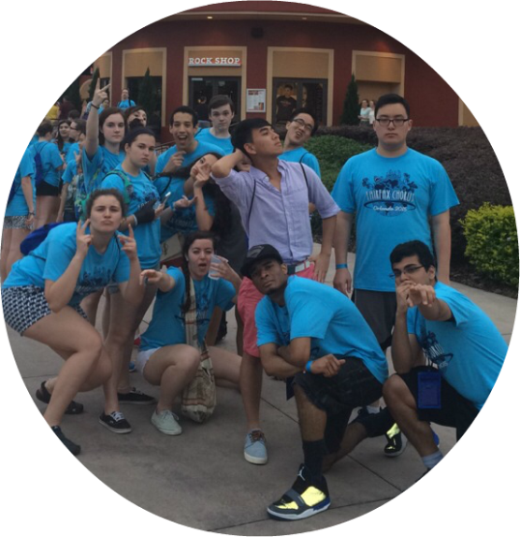
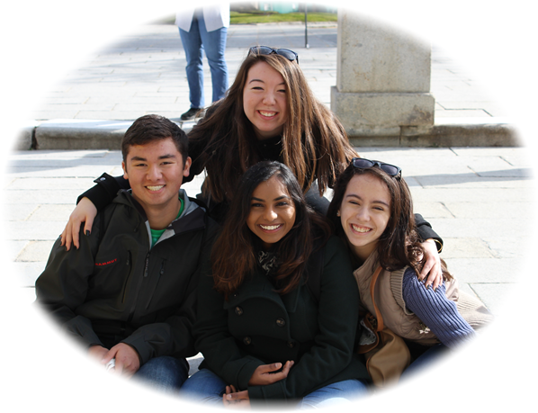
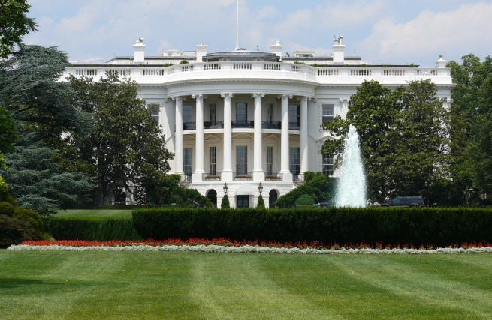
Trip Details

Slide 4
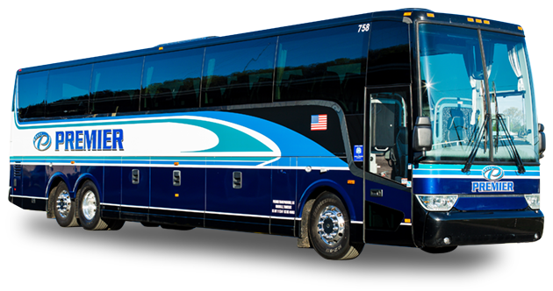
Transportation Provided by
Premier Transportation
Of Knoxville

Slide 5
Premier Transportation
of Knoxville
PREMIER Amenities
Audio/Visual Technology: DVD and CD players; Flat screen in-motion satellite televisions; Surround sound.
Wi-Fi access.
110 outlets/USB ports to charge devices.
Comfortable seating + Footrests.
Luggage storage.
Zoned heat and air conditioning.
Restroom.

Slide 6
Premier Transportation
of Knoxville
PREMIER Safety Features
SmartWave Tire Pressure Monitoring.
Electronic Logs.
Fire suppression systems in the engine compartment.
GPS Insight Monitoring System.
Rear and side cameras as additional safety measures.
Latest equipment innovations, including engine and emission systems.

Slide 7
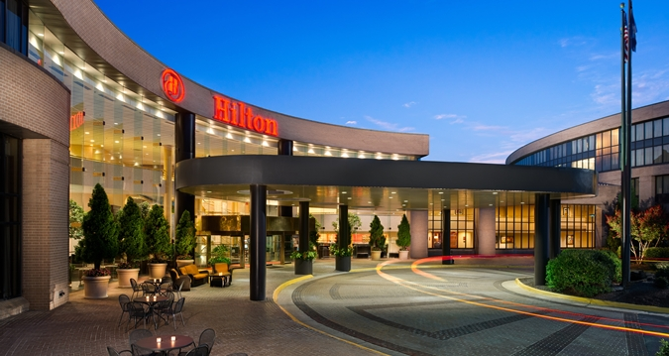
Lodging
Hilton Washington-Dulles Airport

Slide 8
Lodging
Washington Dulles Marriott

Slide 9
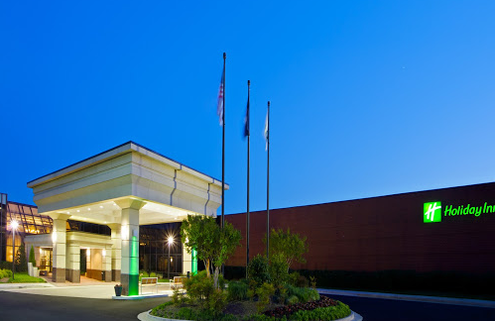
Lodging
Holiday Inn Dulles

Slide 10
Meals
Box lunches provided en route
3 full hot breakfasts
2 lunches provided while in DC
via voucher
3 dinners:
1 at hotel & 2 in DC Restaurants

Slide 11
Escorts
GST Representatives and lead escorts will
accompany the group from Knoxville to
Washington, DC, and back.
Lead escorts will remain at each hotel with group.
Each bus will have a Licensed DC Guide throughout
the tour once in Washington.
All gratuities for drivers, escorts and guides
are included.

Slide 12
Police Escort
Knox County Police will be escorting us on the trip
to and from Washington, DC this year.
We are grateful for their service to their community
and commitment to partner with us!

Slide 13
Nurses
We are in the process of finalizing details to work with the same nursing coordinator to arrange nursing coverage on the trip.
In the past, nurses have been volunteers. They have used their vacation days and purchased their own medical supplies and medications for the trip. It has been communicated to us that they are not able to continue to do this as volunteers.
In order to continue to provide nurses to accompany the trip, we’ve included the fee they requested in the overall package. All supplies and medications will be purchased for them, and a stipend paid to each nurse for their time.
They will travel throughout the tour with the students to administer medication and first aid as needed.

Slide 14
Tour Highlights:
Manassas Battlefields
Kennedy Center
Capitol
Supreme Court Building
Library of Congress
Arlington National Cemetery
Martin Luther King Jr. Memorial
National Zoological Park
Air Force Memorial
FDR Memorial
Iwo Jima Memorial
Mount Vernon
Smithsonian Museums
Vietnam Veterans Memorial
Lincoln Memorial
Jefferson Memorial
Korean Memorial
WWII Memorial

Slide 15
Manassas Battlefields

Slide 16
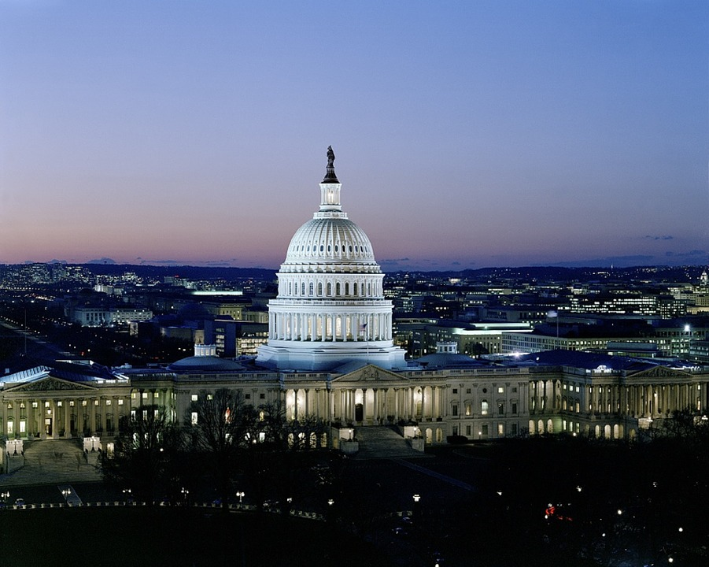
Washington, DC
The United States Capitol

Slide 17
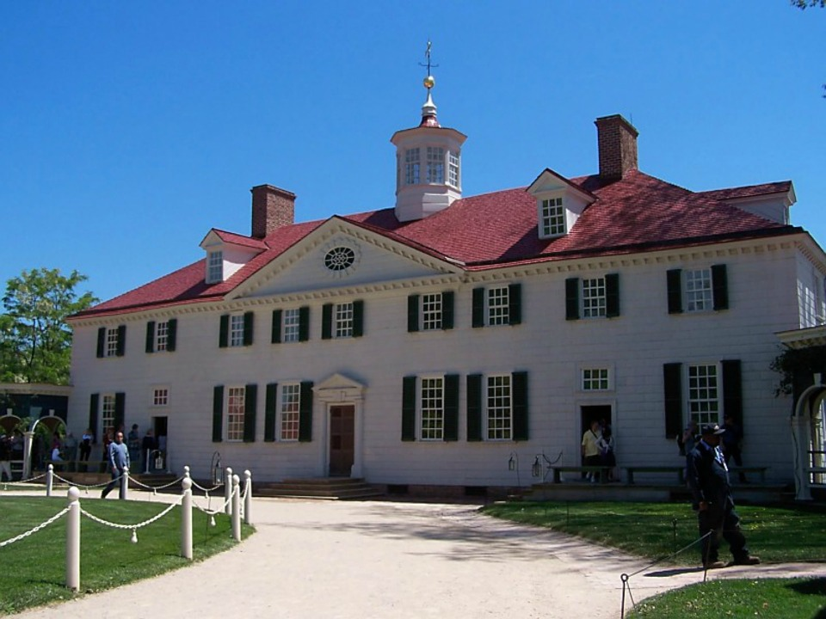
George Washington’s Mount Vernon

Slide 18
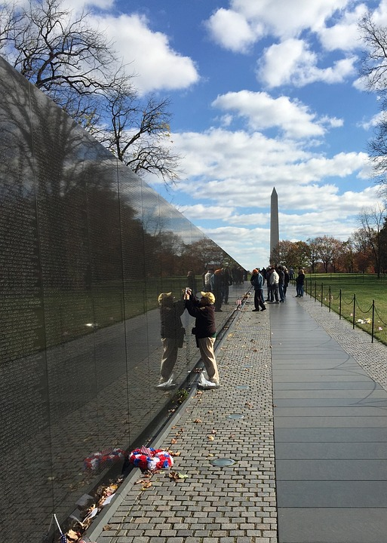
Vietnam Veterans Memorial

Slide 19
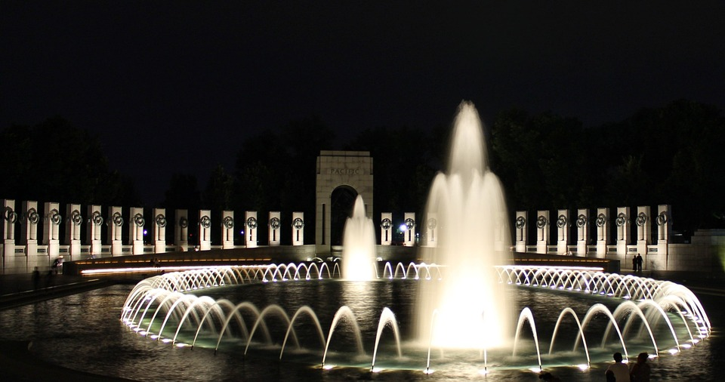
The World War II Memorial
Illuminated Night Tours

Slide 20
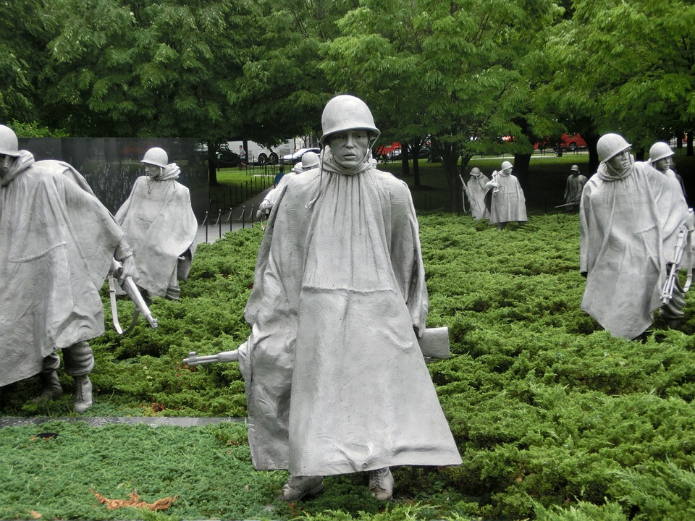
The Korean War Memorial

Slide 21
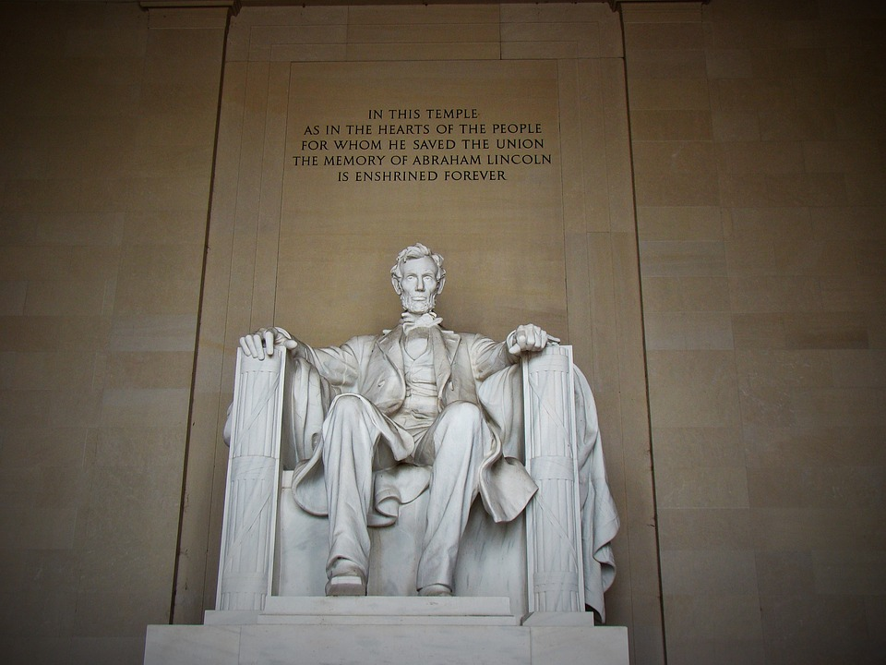
The Lincoln Memorial

Slide 22
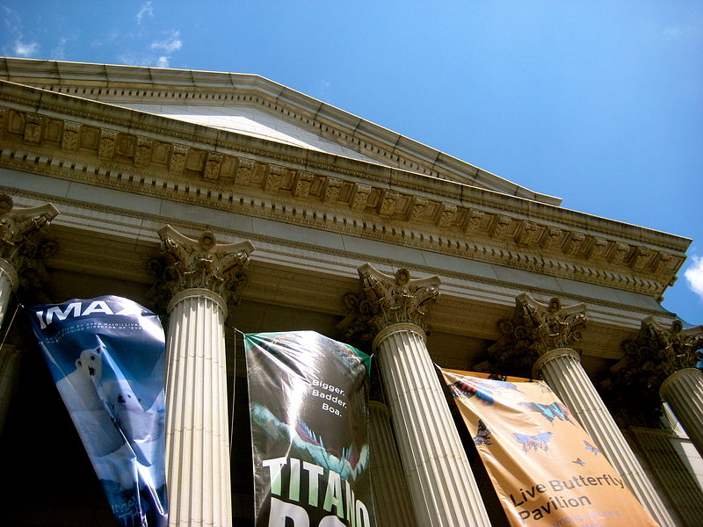
The Smithsonian Museums

Slide 23
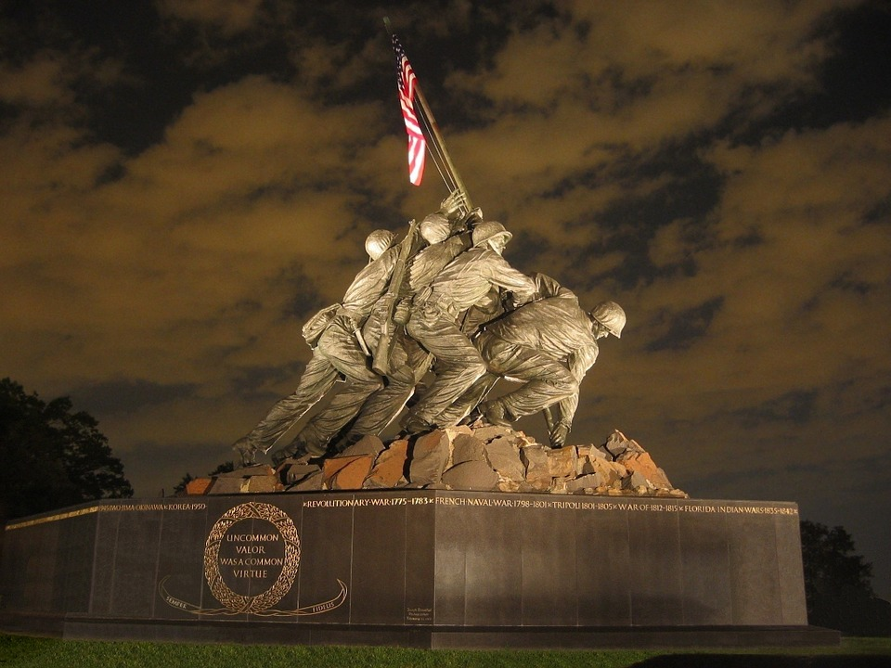
US Marines War Memorial – Iwo Jima

Slide 24
The White House

Slide 25
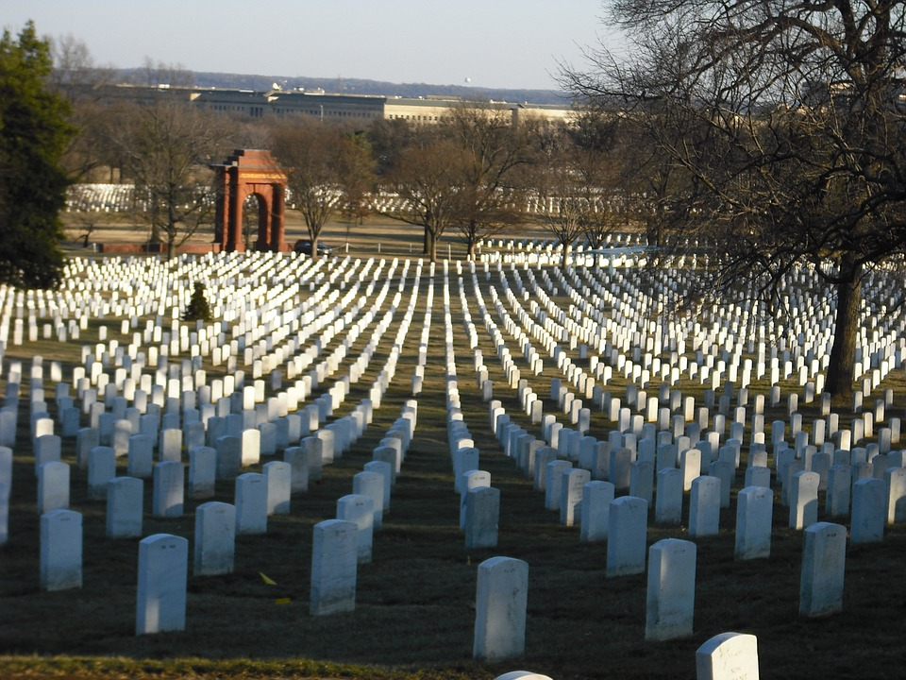
Arlington National Cemetery

Slide 26
Changes from 2017
Meals: 2 Dinners in local restaurants
Photo: Printed Capitol photos to take home
Nurses: Nurses Fees and medical
supplies nurses fees included
Timing: Days shortened to return to hotel earlier

Slide 27
WHAT NEXT?

Slide 28
Trip Cost
$545 Students (4 per room)
$670 Chaperones (2 per room) – per additional chaperones who are not included in the
allowed number per school based on the
1:10 participating students.

Slide 29
Room Supplement Cost
Room Occupancy:
All rooms will have 4 students in them. If your school does not want your students to share rooms with students from another school, your school can opt to pay the following Room Supplement Fees:
Room Supplement Fees:
Triple Occupancy : $45 per person in room
Double Occupancy: $130 per person in room
Single Occupancy: $345 for single person

Slide 30
Chaperone Allowance & Cost
We will provide ONE complimentary chaperone in a double occupancy package for every 10 paid people.
For Example:
10 participants paid – 1 chaperone free
20 participants paid – 2 chaperones free
30 participants paid – 3 chaperones free
…and so on.

Slide 31
Chaperone Allowance & Cost
Knox County requires only 10 students per one chaperone.
IF you go over a number of students divisible by 10 and have to bring another chaperone, they ARE NOT complimentary.
For Example:
19 students sign up
Knox Country requires 2 chaperones go with that number…
1 chaperone is complimentary
1 chaperone must be paid for

Slide 32
Registration, & Payment Schedule
IMPORTANT DATES
REGISTER ONLINE & $50 DEPOSIT BY: November 15, 2017
PAYMENT DUE: $50 paid by December 15, 2017
PAYMENT DUE: $50 paid by January 12, 2018
JANUARY 12, 2018 REGISTRATION CLOSES - LAST DATE FOR NEW REGISTRANTS
PAYMENT DUE: $125 paid by February 1, 2018
PAYMENT DUE: $125 paid by March 1, 2018
FINAL PAYMENT DUE: $145 Students paid by April 1, 2018
$270 Adults paid by April 1, 2018
PLEASE NOTE: PAYMENTS ARE NON-REFUNDABLE
If opting to purchase the Travel Protection Plan offered, it must be purchased by March 1, 2018. Cost is $40 per person

Slide 33
HOW DO WE REGISTER AND PAY?
Payments are simple, secure and private on our GST Registration and payment website.
Each school will have its own Trip ID.
Go to: https://register.gostudenttours.com
Parents will create an account, register their students, and make payments via debit, credit card, or e-check.
The Trip Sponsor for each school will have a log-in of their own to check the back of the system to track registrants for their school.

Slide 34
Additional Information
We will inform schools of their allowed number of chaperones, both paid and complimentary, based on the number of students participating.
As with trips in the past, we encourage teachers to participate as chaperones. Non-teachers or medical staff will be required to submit a background check, at their own expense. This is for the safety of the children.
Information for the trip will constantly be updated on our registration site.
Prior to the trip, there will be a Chaperone Information Meeting to go over all the details, expectations, and roles of the chaperones.

Slide 35
Additional Information
The completed Paper Registration Packets will be turned in at the school, without payments, and sent to GST for each participant – students and adults.
Rooming Lists will be created by the school and sent to GST. We will then assign hotels and buses for each school.
Deadlines for registration deposits, final payments, rooming lists and bus lists must be met.
Principals designee will need to review the participant, rooming and bus lists to make sure all are eligible members of their school community.

Slide 36
THANK YOU!
Thank you for the opportunity to take the Knox County Safety Patrols on their 2018 trip to Washington, DC!
We look forward to making memories that will last a lifetime!
- Your Go Student Tours Team

Slide 37
The Leader in Student
Group Travel
GST CONTACT:
Lisa Scalzo
Lisa@GoStudentTours.com
571-481-1866

